Slide 1
IBM Bluemix with git
Jerry

Slide 2
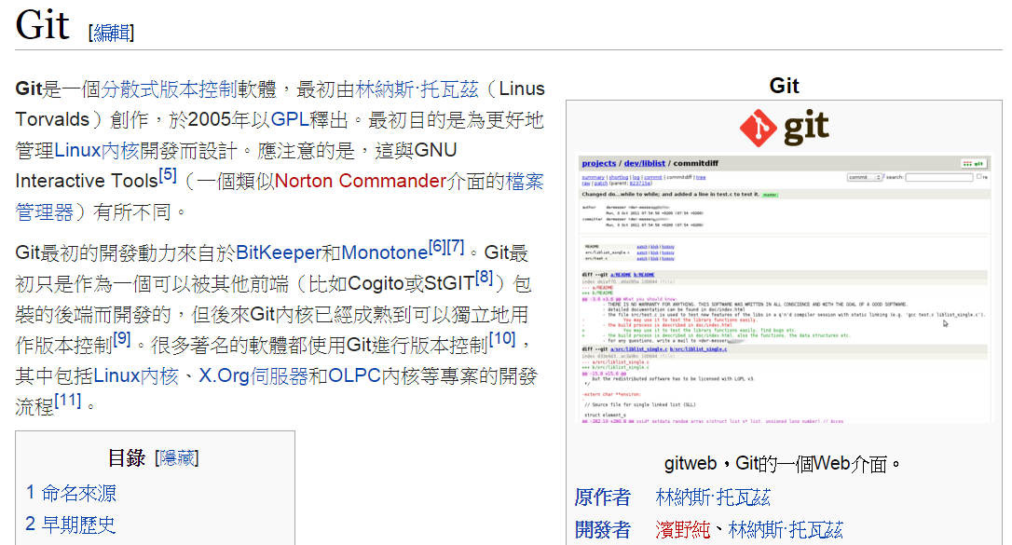
What is Git ?

Slide 3
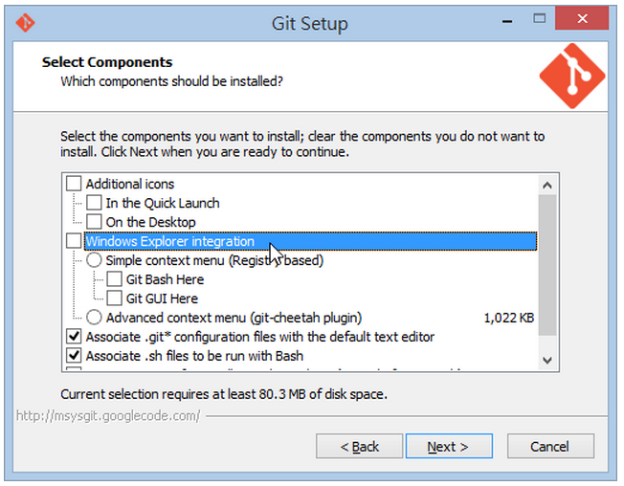
Install Git on windows
其餘 Default

Slide 4
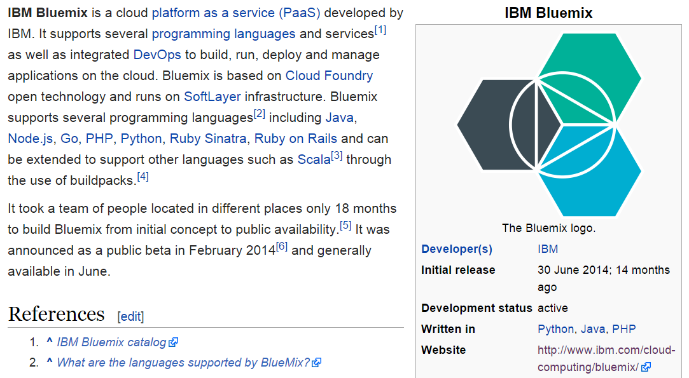
What is Bluemix

Slide 5
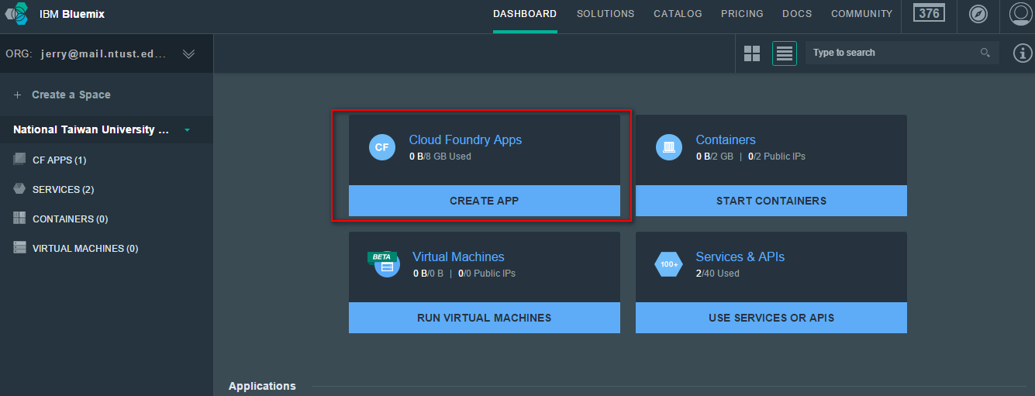

Slide 6
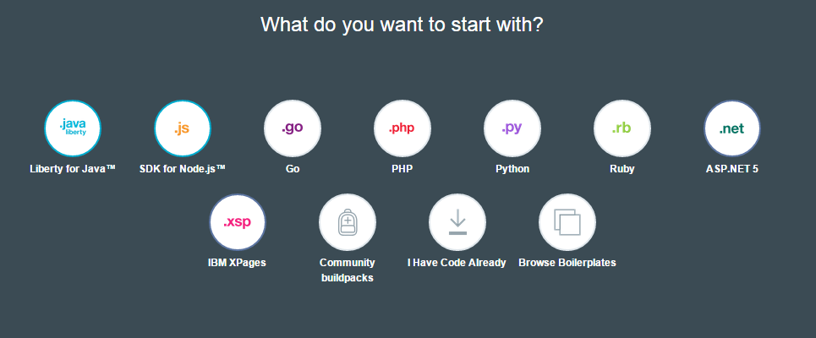

Slide 7
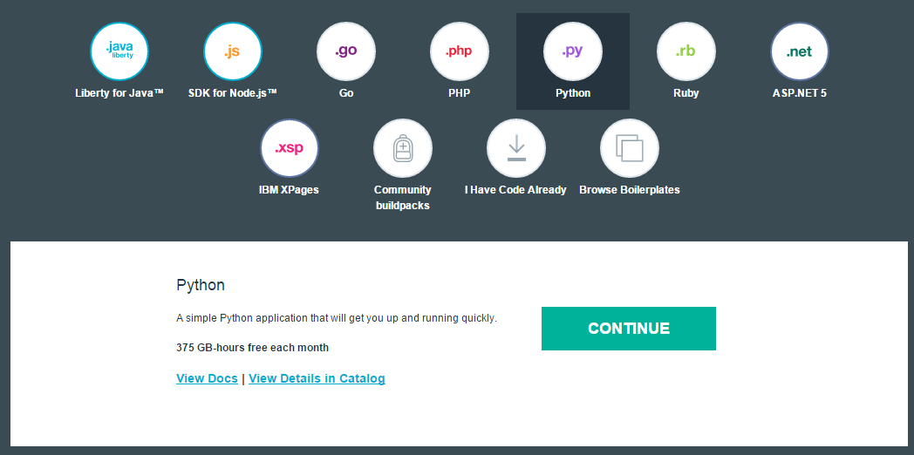

Slide 8
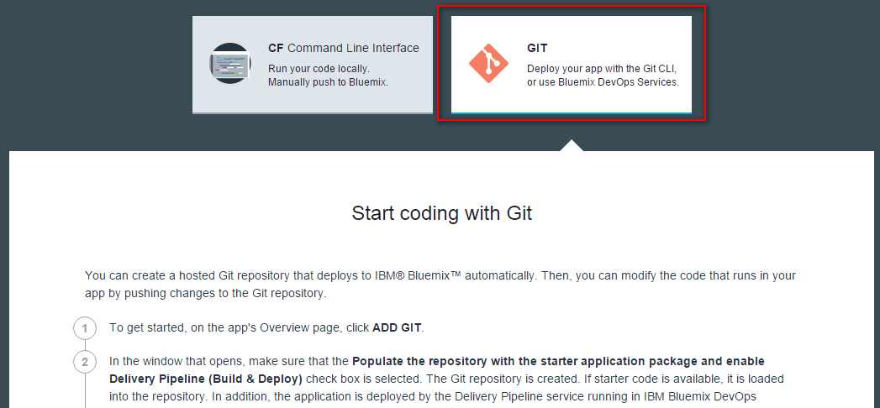

Slide 9
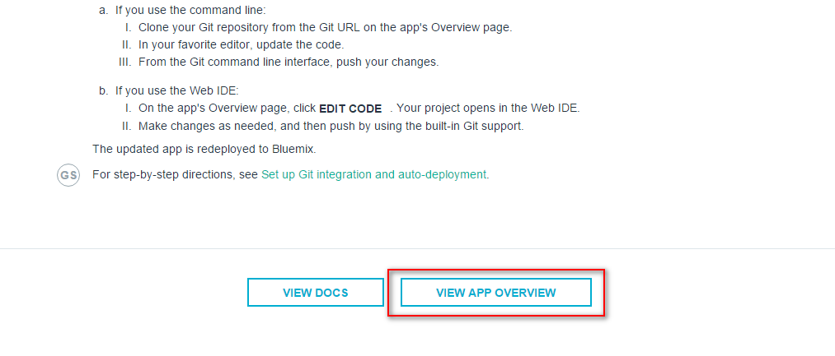

Slide 10
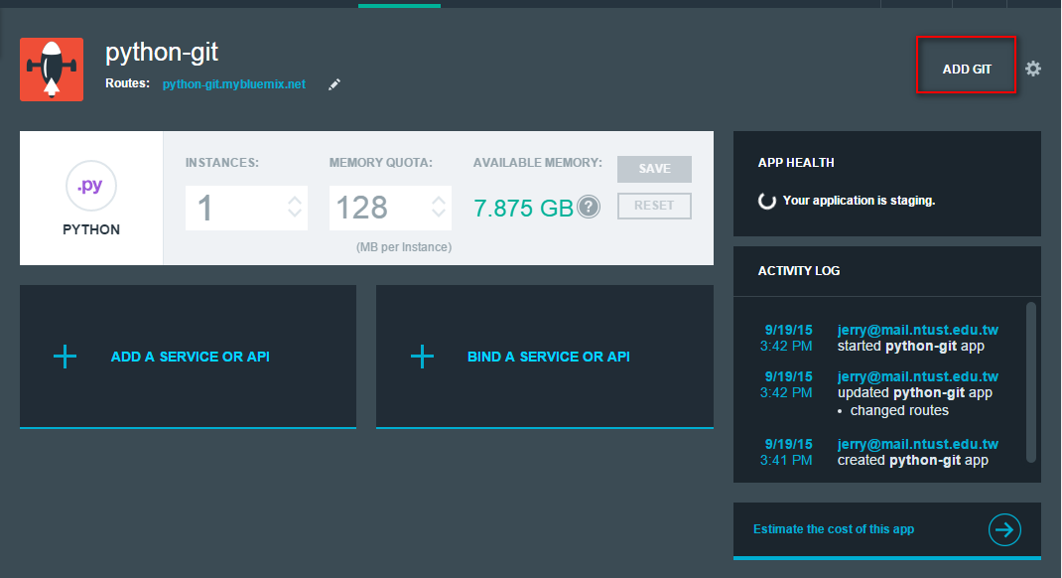

Slide 11
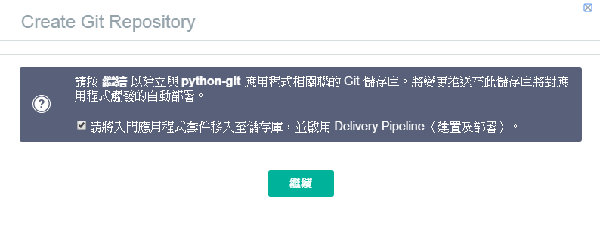

Slide 12
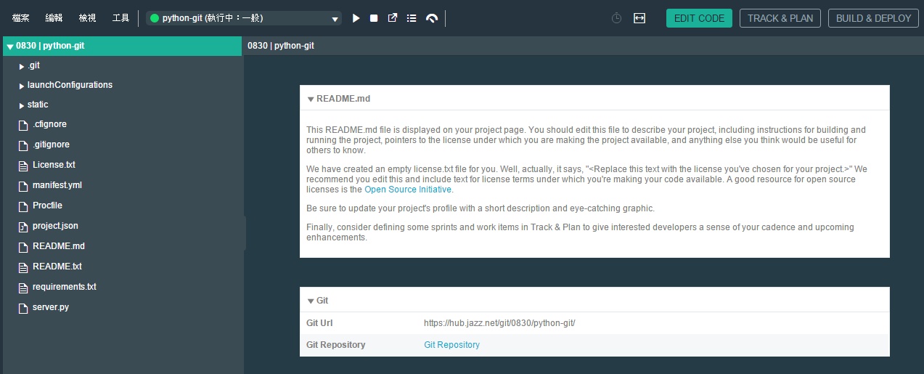

Slide 13
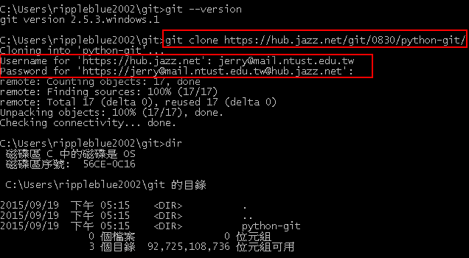

Slide 14
git log
git add .
git commit –m “new file” (-m 版本訊息)
git push

Slide 15
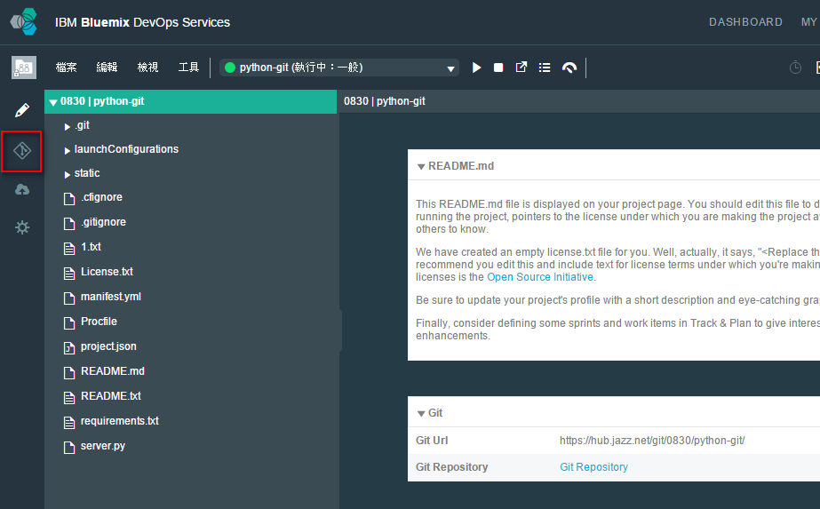

Slide 16
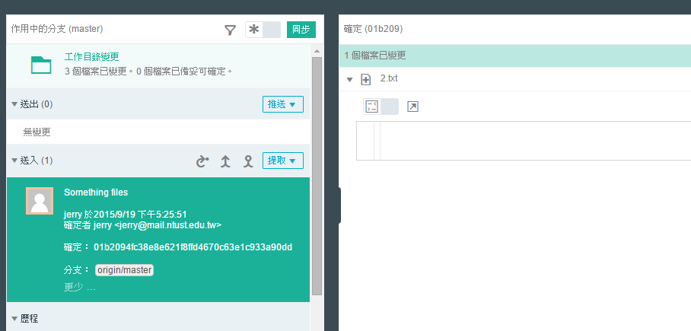

Slide 17
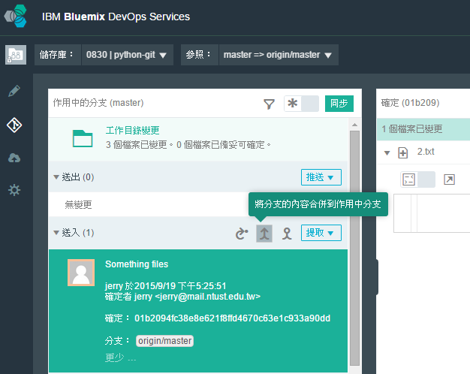

Slide 18
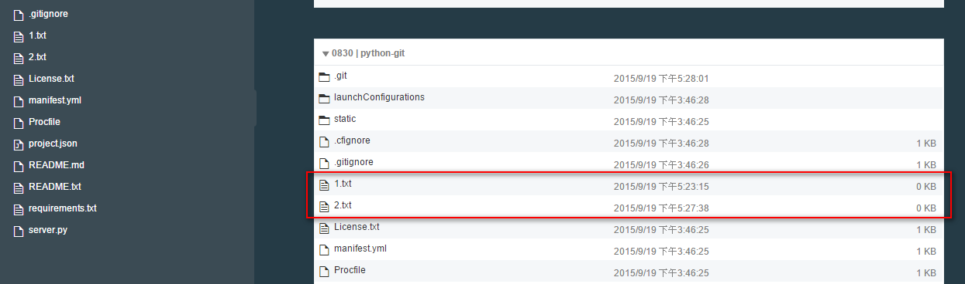

Slide 19
Branch with bluemix
git branch
git branch v1
git checkout v1
git add .
git commit –m “v1 branch”
git push origin v1
git checkout master
git merge new1
git push

Slide 20
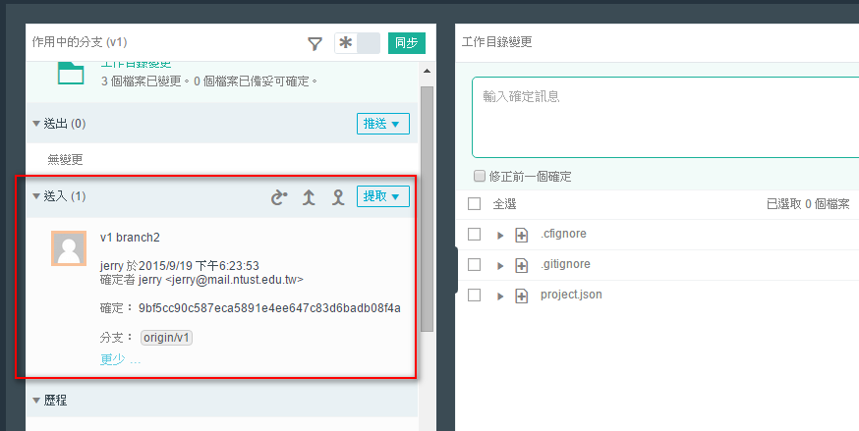

Slide 21
Exercise
Try to commit to repository with bluemix
Try to push files to repository with bluemix

